Slide 1
Elective: Developing Software for Automated MR QC Tests
Neil Heraghty

Slide 2
Introduction
Project aim is to create an application that performs standard MRI QA measurements.
Desire is to perform tests with the minimum of user input.
Long-term aspiration for application to be web-based and free to use / contribute to.

Slide 3
QC Tests

Slide 4
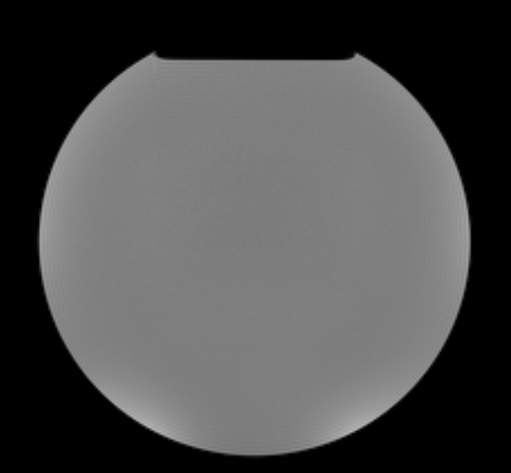
IPEM Report 80 Tests
Uniformity
Eurospin TO1A
MagNET MAGFF-OIL
Find images with a single edge?

Slide 5
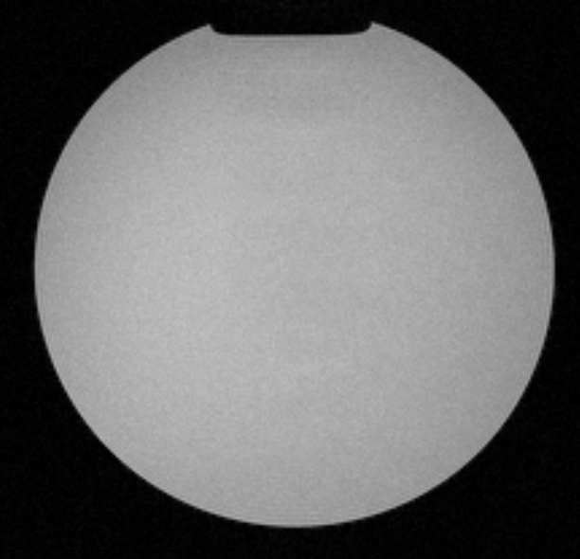
IPEM Report 80 Tests
SNR
Eurospin TO1A
MagNET MAGFF-LOADED
Find images with a single edge?
If/how to distinguish SNR/Uniformity images?

Slide 6
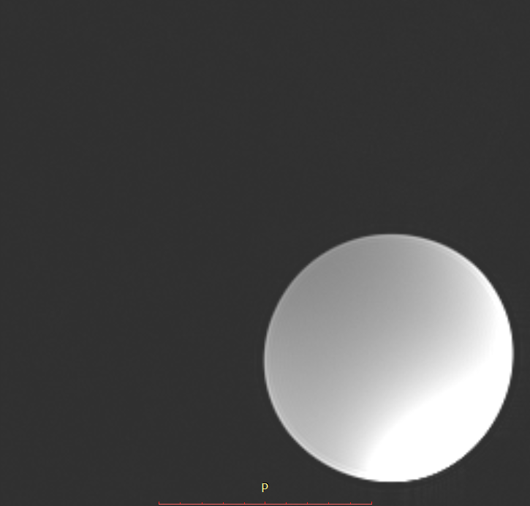
IPEM Report 80 Tests
Ghosting
Eurospin TO8
Small water-based phantom
Find images with a single edge?
Object <25% of image area?

Slide 7
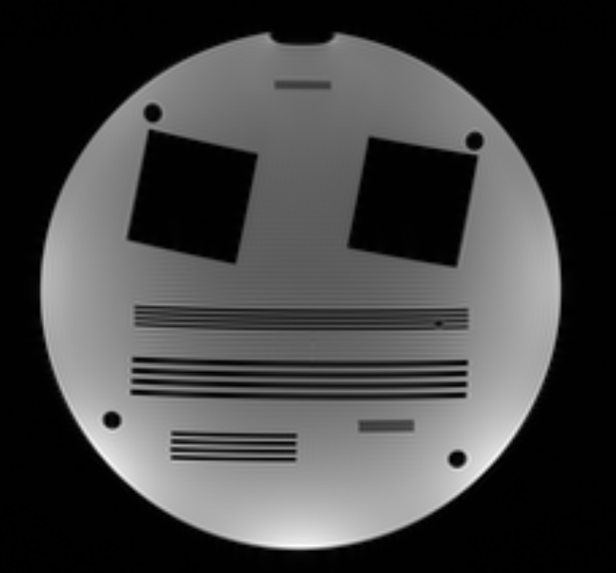
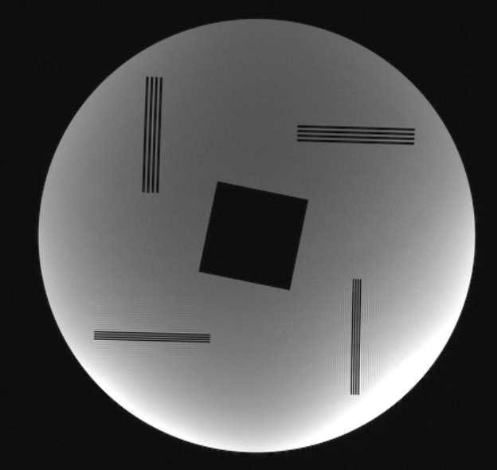
IPEM Report 80 Tests
Spatial Resolution
Eurospin TO4
MagNET MAGRES
Getting trickier...
Look for edges?
Squares?
Cylindrical inserts could be used for MTF...

Slide 8
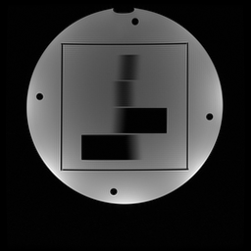
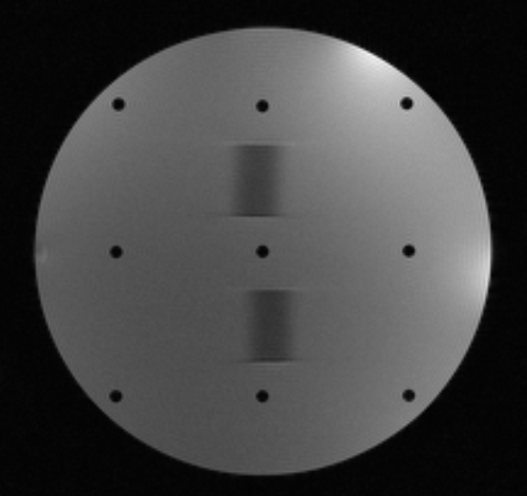
IPEM Report 80 Tests
Geometric Distortion/Linearity
Eurospin TO2
MagNET MAGGEOM
Hard to automate; requires prior knowledge of phantom.
Phantom atlas?

Slide 9
IPEM Report 80 Tests
Slice Width
Eurospin TO2
MagNET MAGGEOM
Needs prior knowledge of plate angle...

Slide 10
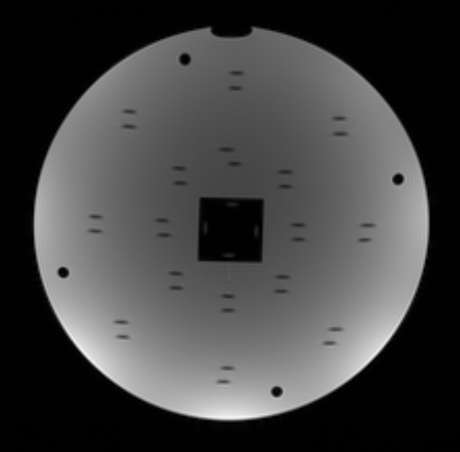
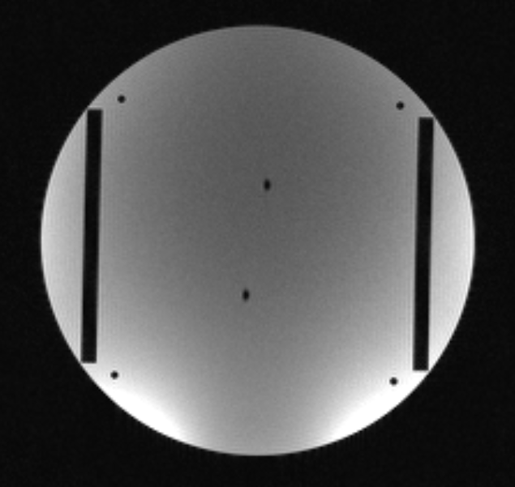
IPEM Report 80 Tests
Slice Position
Eurospin TO3
MagNET MAG_SLICEPOS
More prior knowledge needed...
Is the phantom set up correctly?

Slide 11
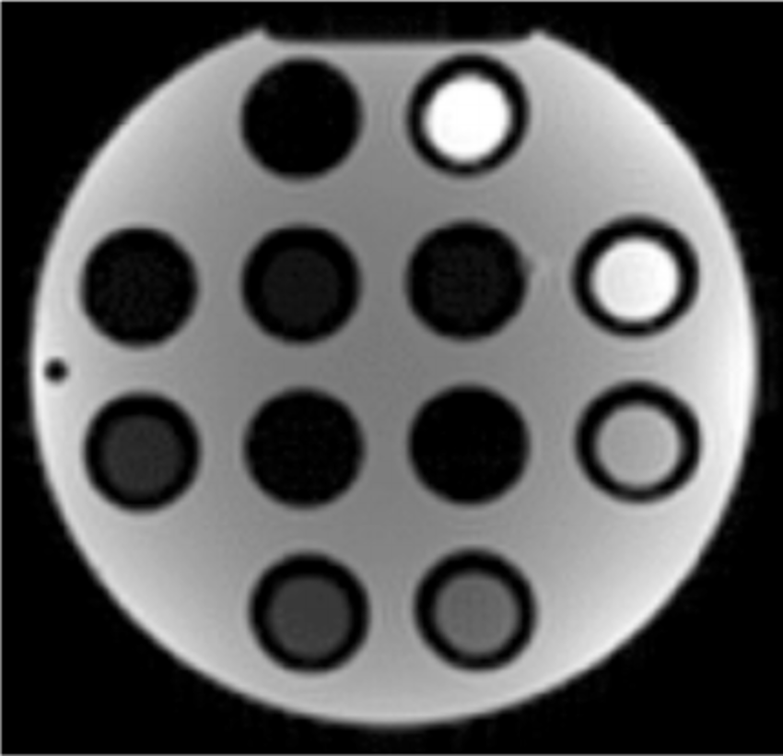
IPEM Report 80 Tests
T1/T2 Relaxation Times
Eurospin TO5
Precise prior knowledge required – probably impossible to automate.

Slide 12
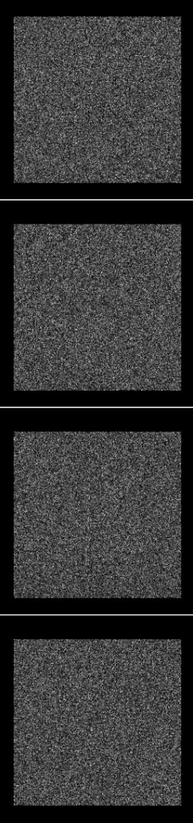
Other tests
RF Interference
Measurement of noise
Not clear on the conditions of this test...

Slide 13
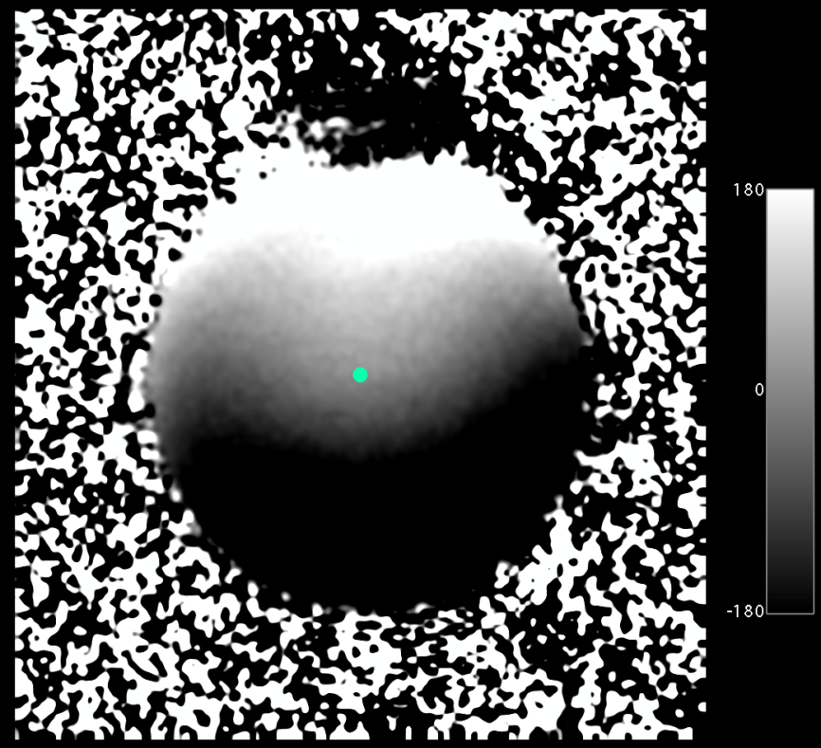
Other tests
B₀ Homogeneity
Currently a qualitative test
Not sure what this image shows...

Slide 14
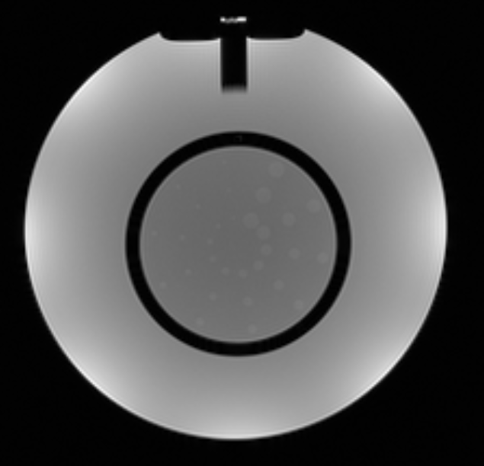
Other tests
What other tests might be desirable?

Slide 15
Problems
Prior knowledge about test/phantom.
What to do when test requires multiple images (e.g. SNR, RF Interference, MAG_SLICEPOS)?

Slide 16
Analysis of Daily QC

Slide 17
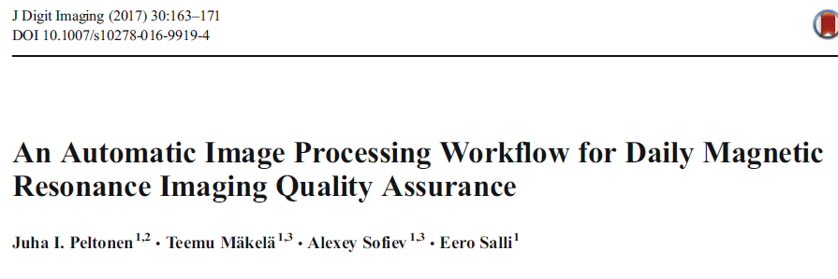
Analysis of Daily QC
Routine QA with manufacturer phantoms

Slide 18
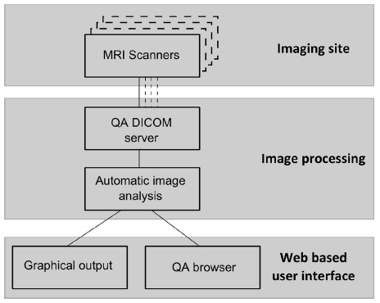

Slide 19
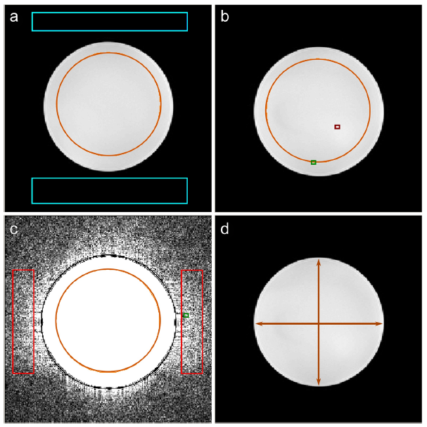
SNR
Uniformity
Ghosting
Distortion

Slide 20
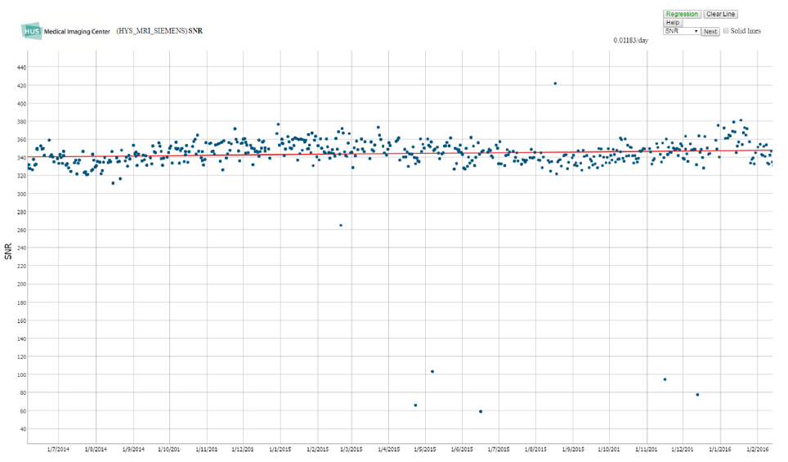

Slide 21
The Plan – Part 1
Write Python scripts to test uniform phantoms
Test using historical data from PACS
Develop system for automatically testing all daily/weekly flood phantom data
Record results
Alert users / physics if out of tolerance

Slide 22
The Plan – Part 2
Develop web application to allow anyone to upload a DICOM image and perform the same tests
Add more tests / accepted test phantoms

